Slide 1

DATABASE SYSTEMS
PROGRAM STUDI TEKNIK INFORMATIKA
UIVERRSITAS TARUMANAGARA

Slide 2
Course Schedule
Introduction to Databases 7 – 9 Entity-Relationship Modeling
Database Environment 10–12 Normalization
The Relational Model 13. Conceptual Database Design
Relational Algebra 14. Logical Database Design
Relational Calculus
Database Planning, Design, and Administration

Slide 3
Chapter 1
Introduction to Databases

Slide 4
Examples of Database Applications
Purchases from the supermarket
Purchases using your credit card
Booking a holiday at the travel agents
Using the local library
Taking out insurance
Using the Internet
Studying at university

Slide 5
File-Based Systems
Collection of application programs that perform services for the end users (e.g. reports).
Suatau program aplikasi yang memberikan layanan kepada pengguna akhir (misal laporan).
Each program defines and manages its own data.
Setiap program yang dibuat didefinisikan dan mengelola datanya sendiri

Slide 6
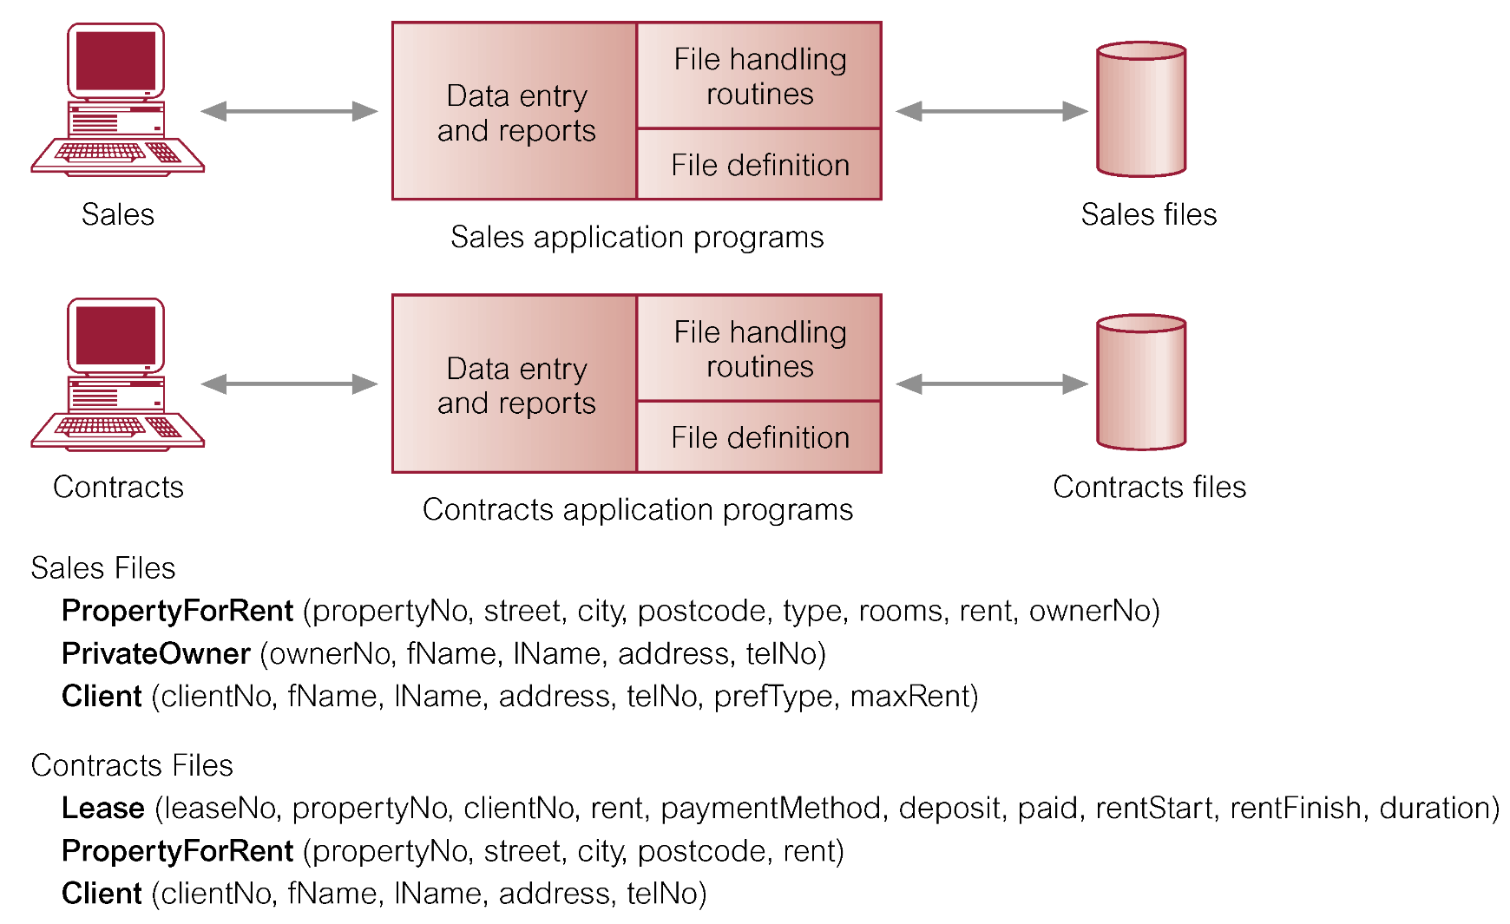
File-Based Processing

Slide 7
Limitations of File-Based Approach
Separation and isolation of data (pemisahan dan isolasi data)
Each program maintains its own set of data (setiap program mengatur kumpulan datanya sendiri)
Users of one program may be unaware of potentially useful data held by other programs (pengguna satu program mungkin tidak menyadari bahwa ada data yang berpotensi dapat digunakan oleh program lainnya)
Duplication of data (kerangkapan data)
Same data is held by different programs (data yang sama dimiliki juga oleh program yang berbeda).
Wasted space and potentially different values and/or different formats for the same item (ruang tidak terpakai dan berpotensi terjadinya perbedaan nilai atau format untuk item yang sama).

Slide 8
Limitations of File-Based Approach
Data dependence (ketergantungan data)
File structure is defined in the program code (struktur file didefinisikan pada program)
Incompatible file formats (format file yang tidak kompatibel)
Programs are written in different languages, and so cannot easily access each other’s files (program yang ditulis dalam bahasa berbeda, sehingga tidak mudah mengakses file lainnya)
Fixed Queries/Proliferation of application programs
Programs are written to satisfy particular functions (program ditulis untuk memenuhi fungsi tertentu).
Any new requirement needs a new program (setiap ada kebutuhan baru, perlu program baru).

Slide 9
Database Approach
Arose because (muncul karena):
Definition of data was embedded in application programs, rather than being stored separately and independently (data didefinisikan pada program aplikasi, bukan disimpan secara terpisah dan mandiri).
No control over access and manipulation of data beyond that imposed by application programs (tidak ada kontrol terhadap akses dan manipulasi data di luar program aplikasi nya).
Result:
the database and Database Management System (DBMS).

Slide 10
Database
Shared collection of logically related data (and a description of this data), designed to meet the information needs of an organization (sekumpulan data yang bersifat logika dan saling terkait (termasuk deskripsi data ini), dirancang untuk memenuhi kebutuhan informasi suatu organisas).
System catalog (metadata) provides description of data to enable program–data independence (data yang bersifat mandiri bisa digunakan oleh program melalui katalog sistem).
Logically related data comprises entities, attributes, and relationships of an organization’s information (data terhubung secara logika terdiri dari entitas, atribut, dan hubungan dari informasi organisasi).

Slide 11
Database Management System (DBMS)
A software system that enables users to define, create, and maintain the database and that provides controlled access to this database (sebuah perangkat lunak yang memungkinkan pengguna untuk mendefinisikan, membuat, dan memelihara basis data dan menyediakan akses terkontrol ke basis data ini).

Slide 12
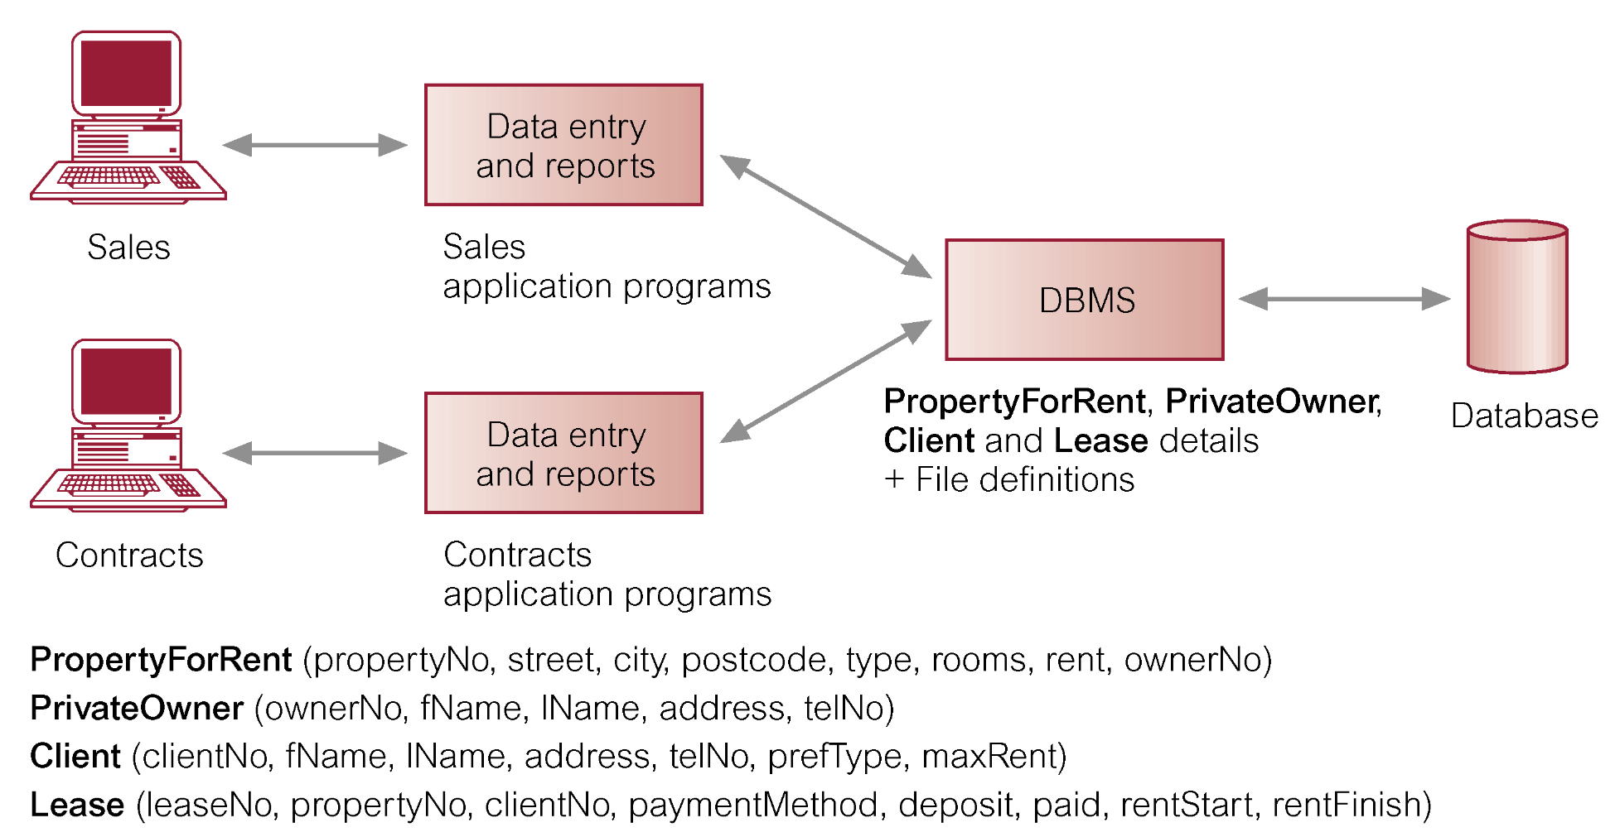
Database Management System (DBMS)

Slide 13
Database Approach
Data definition language (DDL).
Permits specification of data types, structures and any data constraints (digunakan untuk mendefinisikan/membuat spesifkasi tipe data, struktur, dan batasan data, DDL digunakan juga untuk mengubah, serta menghapus basisdata dan obyek yang diperlukan dalam basis data).
All specifications are stored in the database (semua spesififkasi disimpan dalam basis data).
Data manipulation language (DML).
General enquiry facility (query language) of the data (penyediaan fasilitas yang bersifat umum, yaitu bahasa kueri untuk memanipulasi dan pengambilan data pada basis data).

Slide 14
Database Approach
Controlled access to database may include:
A security system.
An integrity system.
A concurrency control system.
A recovery control system.
A user-accessible catalog.
A view mechanism.
Provides users with only the data they want or need to use.

Slide 15
Views
Allows each user to have his or her own view of the database.
A view is essentially some subset of the database.

Slide 16
Views
Benefits include:
Reduce complexity;
Provide a level of security;
Provide a mechanism to customize the appearance of the database;
Present a consistent, unchanging picture of the structure of the database, even if the underlying database is changed.

Slide 17
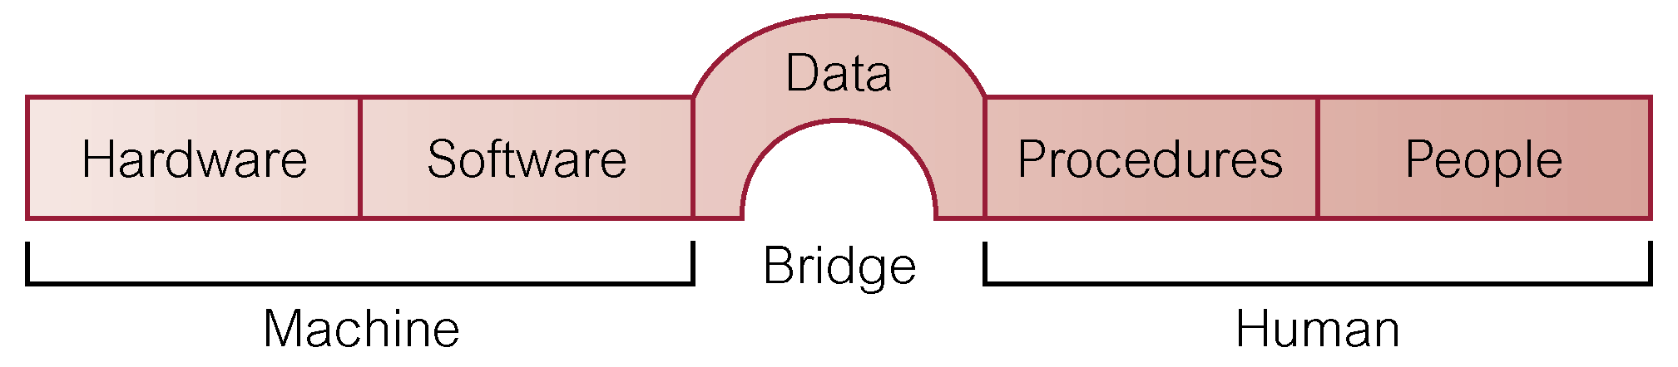
Components of DBMS Environment

Slide 18
Components of DBMS Environment
Hardware
Can range from a PC to a network of computers.
Software
DBMS, operating system, network software (if necessary) and also the application programs.
Data
Used by the organization and a description of this data called the schema.

Slide 19
Components of DBMS Environment
Procedures
Instructions and rules that should be applied to the design and use of the database and DBMS.
People

Slide 20
Roles in the Database Environment
Data Administrator (DA)
Database Administrator (DBA)
Database Designers (Logical and Physical)
Application Programmers
End Users (naive and sophisticated)

Slide 21
History of Database Systems
First-generation
Hierarchical and Network
Second generation
Relational
Third generation
Object Relational
Object-Oriented

Slide 22
Advantages of DBMSs
Control of data redundancy
Data consistency
More information from the same amount of data
Sharing of data
Improved data integrity
Improved security
Enforcement of standards
Economy of scale

Slide 23
Advantages of DBMSs
Balanced conflicting requirements
Improved data accessibility and responsiveness
Increased productivity
Improved maintenance through data independence
Increased concurrency
Improved backup and recovery services

Slide 24
Disadvantages of DBMSs
Complexity
Size
Cost of DBMS
Additional hardware costs
Cost of conversion
Performance
Higher impact of a failure

Slide 25
Discuss the roles of the following personnel in the database environment
(a) Data Administrator
(b) Database Administrator
(c) Database Designer
(d) Application Developer
(e) End-Users
List four government sectors in your country that use database systems.

Slide 26
Thank You
Reference: Database Systems A Practical Approach to Design, Implementation, and Management Fourth Edition.
Thomas M. Connolly and Carolyn E. Begg

